Slide 1
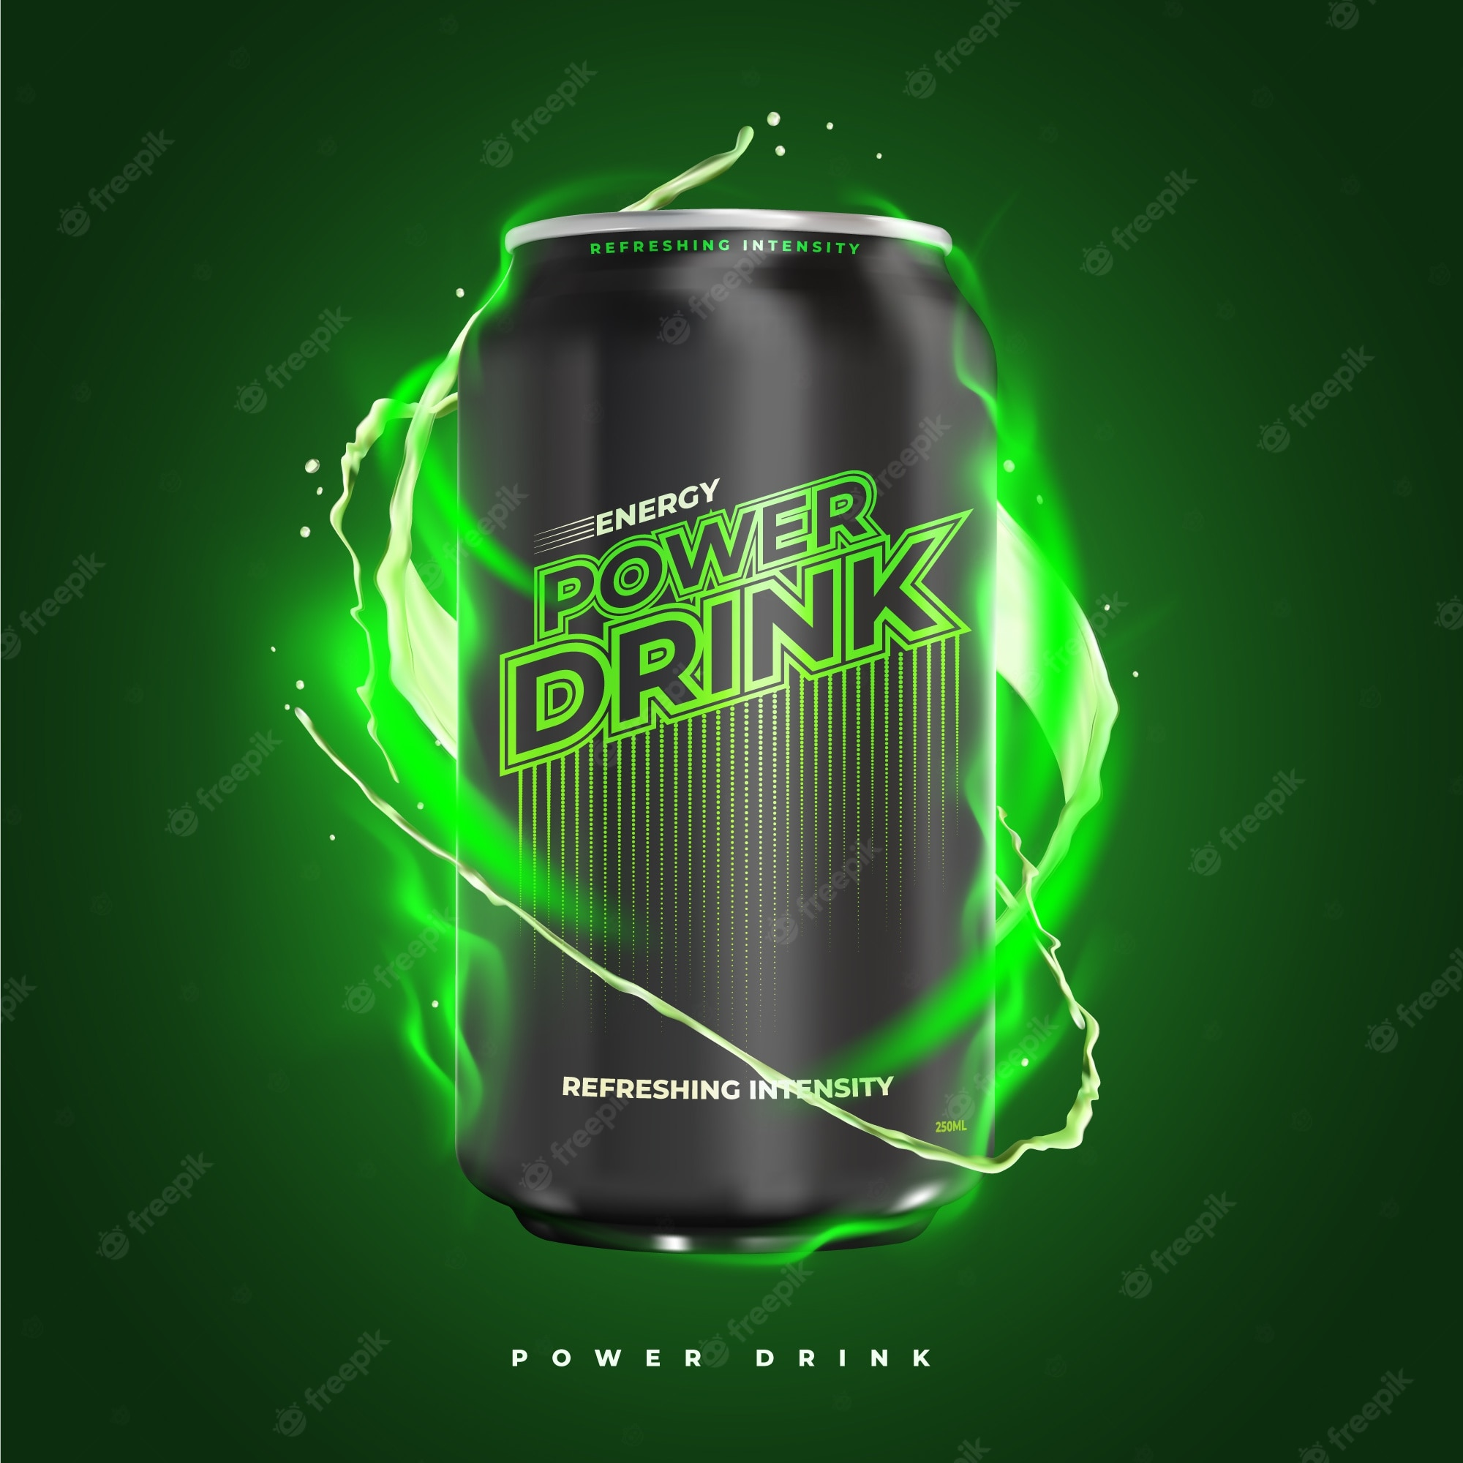
Market Analysis And Insights For Energy Drink Marketing Strategy
Ketul Patel

Slide 2
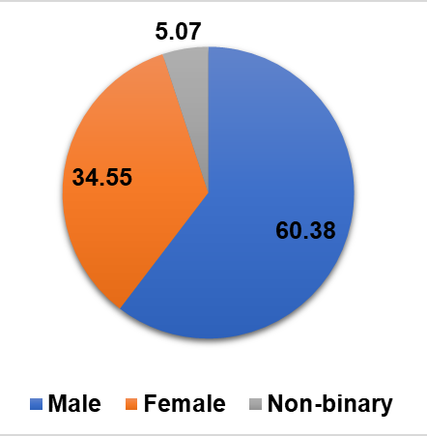
Demographic Insights
Who prefers energy drink more?
Higher proportion of male users (60%) compared to female users (35%) .
Explore initiatives that attract and engage more female users, such as tailored marketing campaigns

Slide 3
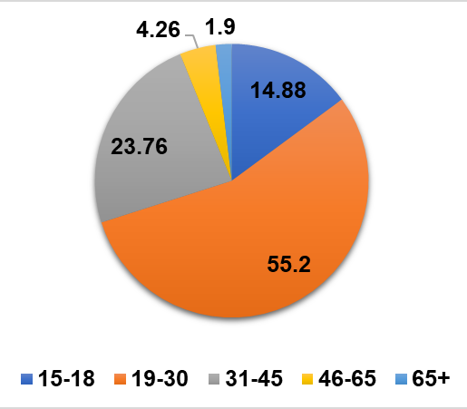
Demographic Insights
Which age group prefers energy drinks more?
Attracts younger individuals, with a significant focus on the 15-30 age bracket.

Slide 4
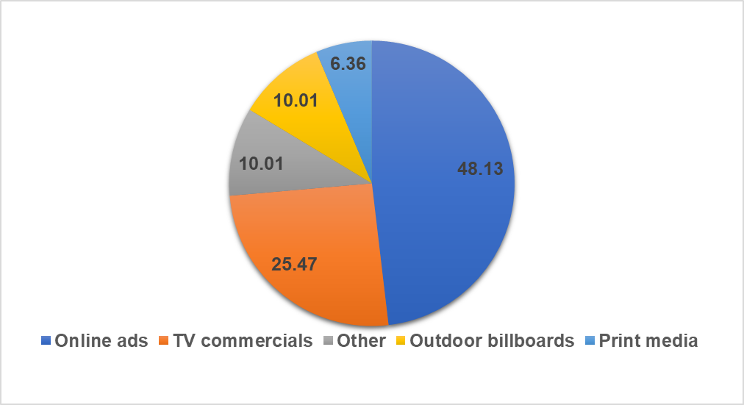
Demographic Insights
Which type of marketing reaches the most Youth (15-30)?
48% of youth rely on online ads as their primary source of information.
TV commercials are the source of information for 25% of youth.
Targeted ads on social media platforms can effectively reach and engage the youth audience.

Slide 5
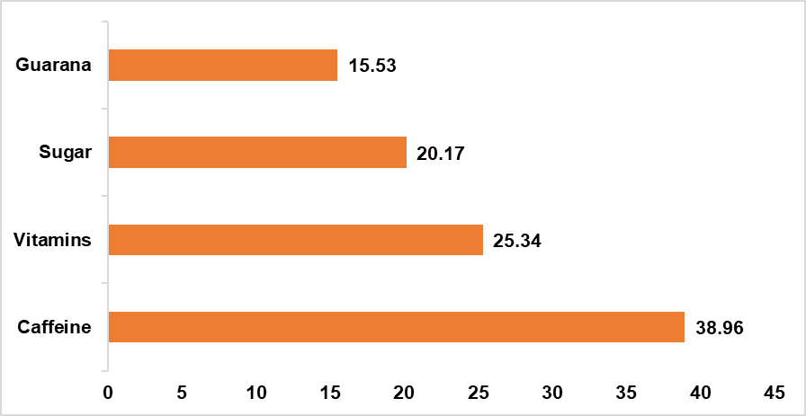
Consumer Preferences
What are the preferred ingredients of energy drinks among respondents?
39% of respondents prefer caffeine as an ingredient in energy drinks, while 25% prefer vitamins.
Energy drink manufacturers and marketers can highlight the presence of caffeine and vitamins in their products to appeal to these segments of the market.
Emphasizing the energy-boosting effects of caffeine and the potential health benefits of added vitamins can help attract and satisfy these segments of the market.

Slide 6
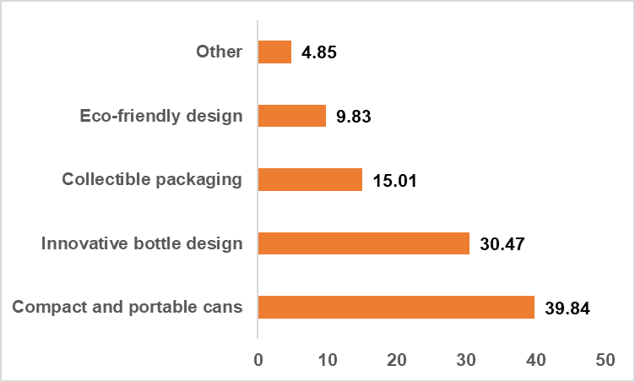
What packaging preferences do respondents have for energy drinks?
Consumer Preference
40% of respondents prefer energy drink packaging in compact and portable cans, while 30% prefer innovative bottle designs.
Focus on designing compact and portable cans that are convenient for consumers to carry and consume on the go.
Invest in innovative bottle designs to appeal to consumers who appreciate unique and visually appealing packaging.

Slide 7
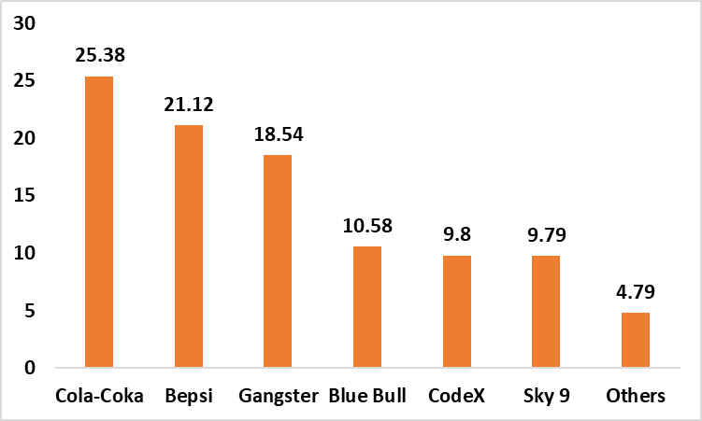
Competition Analysis
Who are the current market leaders?
Cola-Coka and bepsi hold the highest market share in the energy drink industry, while codeX currently has a 10% market share.
To increase market share, codeX can focus on several strategies:
Differentiation
Marketing and Promotion
Product Innovation
Distribution Expansion
Consumer Engagement

Slide 8
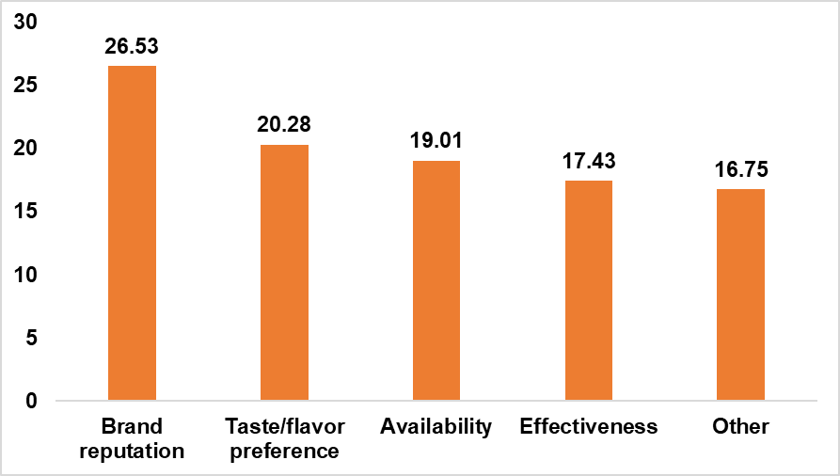
Competition Analysis
What are the primary reasons consumers prefer those brands over ours?
Brand reputation has the highest score of 26.42%. This indicates that focusing on enhancing and maintaining a positive brand reputation should be a priority in product development efforts. Strategies that reinforce trust, quality, and reliability can help build a strong brand reputation.
Availability follows with a score of 19.9%. This suggests that improving the accessibility and availability of the product should be given attention. Expanding distribution networks, strengthening relationships with retailers, and ensuring consistent product availability can contribute to meeting consumer demand.

Slide 9
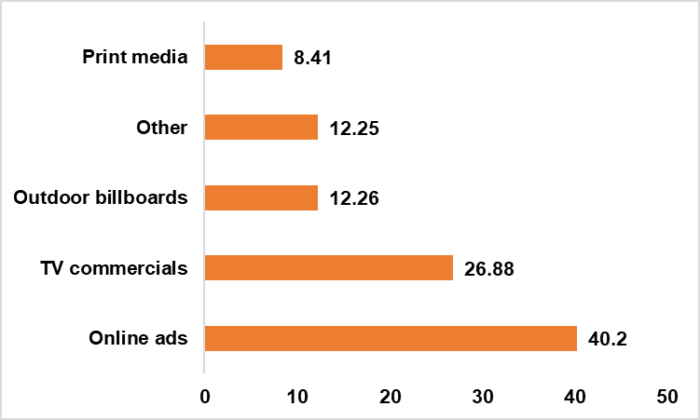
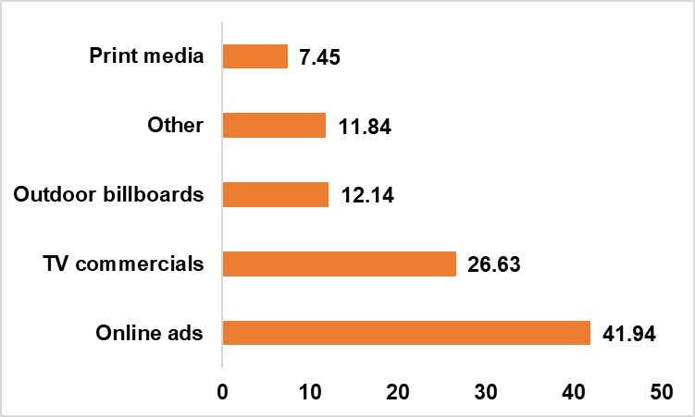
Marketing Channels and Brand Awareness
Which marketing channel can be used to reach more customers?
How effective are different marketing strategies and channels in reaching our customers?
CodeX
40% of youth rely on online ads as their primary source of information.
TV commercials are the source of information for 27% of youth.
Prioritizing online advertising efforts is recommended based on the data. Targeted ads on social media platforms can effectively reach and engage the youth audience.

Slide 10
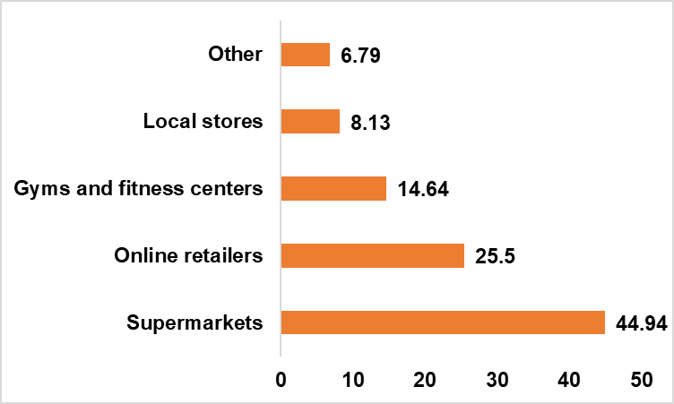
Purchase Behavior
Where do respondents prefer to purchase energy drinks?
Supermarkets and online retailers are the key distribution channels for energy drinks.
Establish a strong presence in these retail spaces to cater to consumer preferences and ensure availability in convenient locations.
Considering partnerships with gyms and fitness centers may provide opportunities to reach health-conscious individuals who often seek energy drinks as a supplement for their workouts.

Slide 11
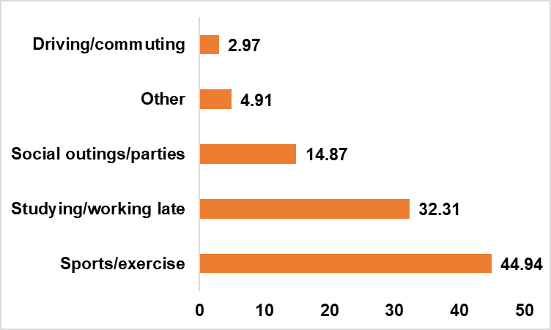
What are the typical consumption situations for energy drinks among respondents?
Purchase Behavior
45%, consume energy drinks during sports or exercise activities. Energy drinks are often used to provide an energy boost, enhance performance, and increase endurance during physical activities.
32% of respondents reported consuming energy drinks when studying or working late. Energy drinks are commonly consumed to combat fatigue, improve focus, and stay awake during late-night work hours.

Slide 12
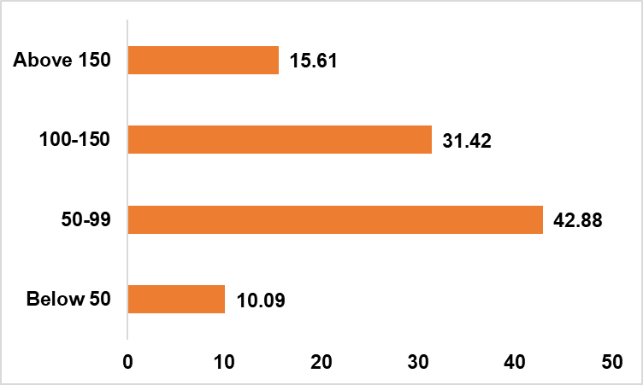
What factors influence respondents' purchase decisions, such as price range and limited edition packaging?
Purchase Behavior
Significant portion of respondents prefer energy drinks in the price range of 50-150 rupees.
This suggests that a mid-range pricing strategy could be effective in targeting this majority segment.

Slide 13
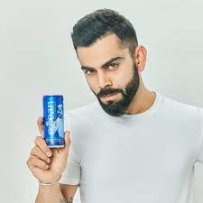
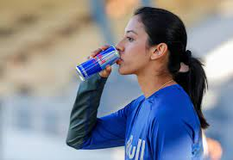
Who can be a brand ambassador, and why?
Virat Kohli
Well-known and accomplished cricketer.
Represents fitness, agility, and a strong work ethic.
Resonates with young people interested in sports and fitness.
Strong following and influence can increase brand awareness and credibility.
Smriti Mandhana
Successful women's cricketer.
Inspires and connects with young women interested in sports and fitness.
Diversifies the brand's appeal and creates a connection with the female consumer base.

